Slide 1


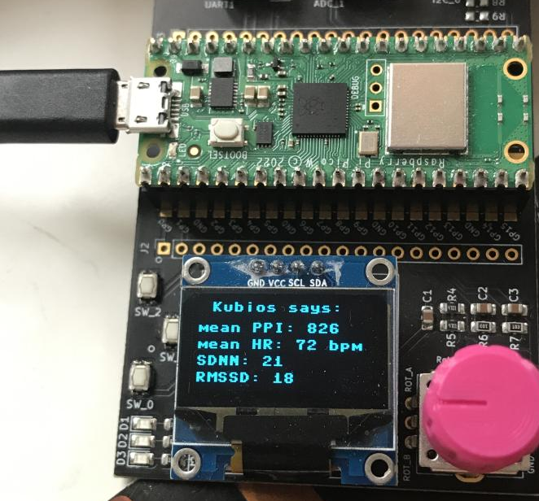



IPISTRESS: RASPBERRY PI PICO AS STRESS MONITOR
ACCESSORIES
FOR YOUR HEALTH CARE
By Group 3
Mong Phan, Khai Cao, Berhanu Muche, Xuan Dang

Slide 2


CONTENT
1
2
3
4
Vision and goals
Features and usage
System Architecture
Further development ideas
5
6
7
8
9
Technologies used
Algorithm
Testing
Lessons learned
Contact Support

Slide 3

VISION
01
Improve health outcomes
02
Promote fitness
Enable remote patient monitoring
03
04
Advance medical research

Slide 4


GOALS
Designing and implementing a working heart rate monitor using a Raspberry Pi Pico:
Understanding the physiology of the heart and how heart rate is measured.
Apply programming skills practically

Slide 5
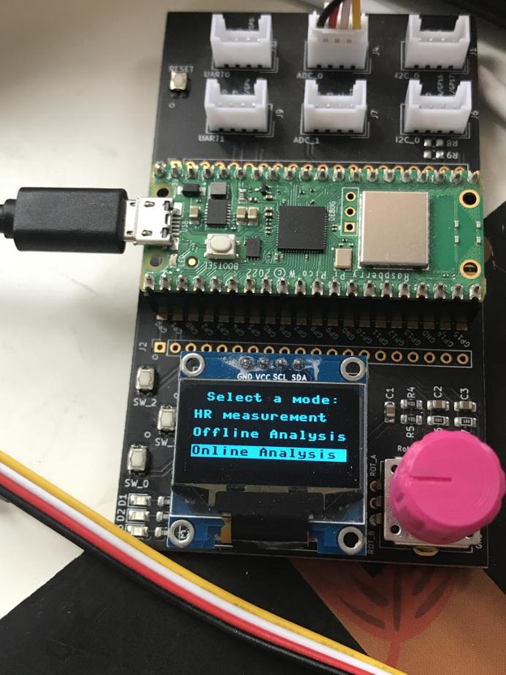
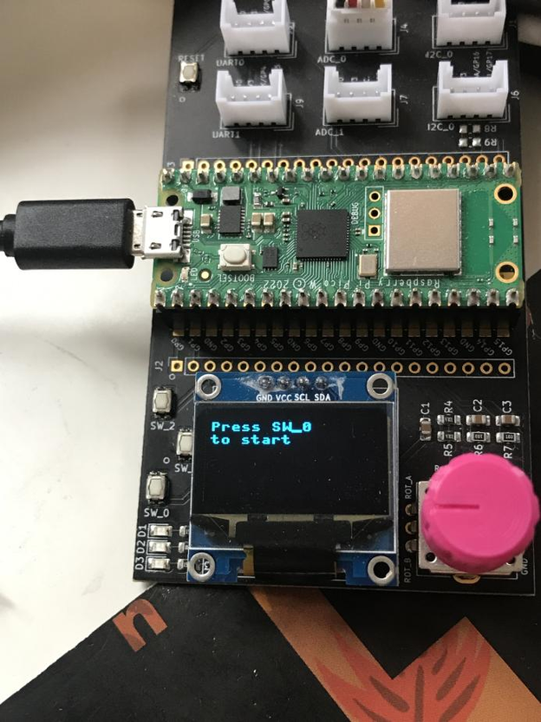

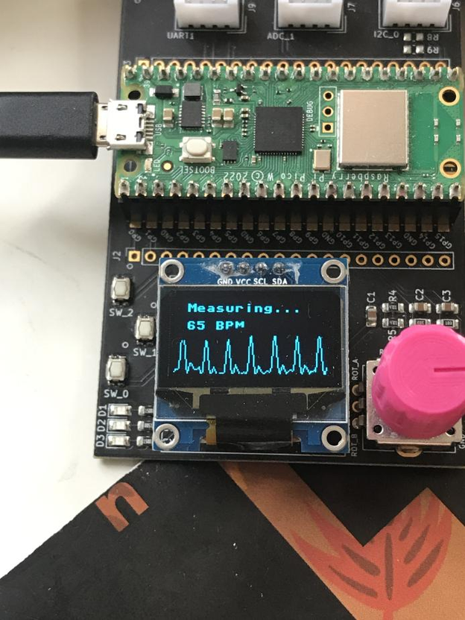
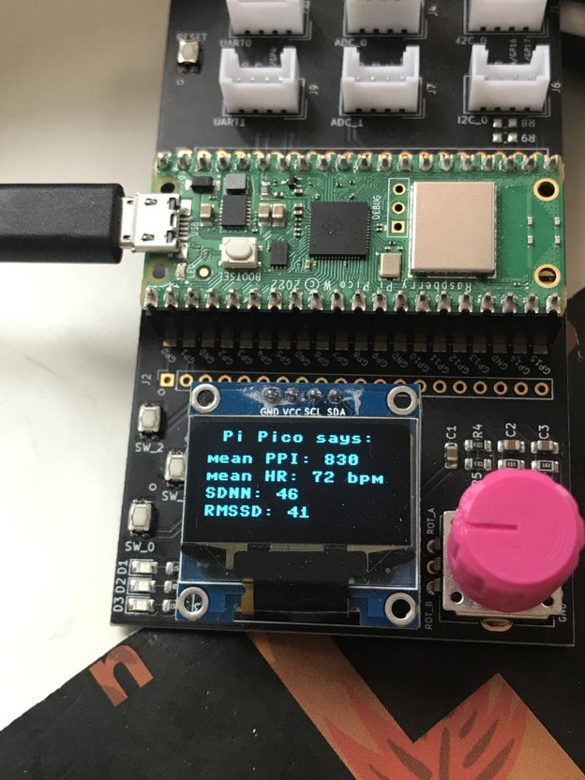

FEATURES AND USAGE
MODE SELECTION
PRESS TO START
HR MEASURING
OFFLINE RESULTS
KUBIOS RESULTS

Slide 6
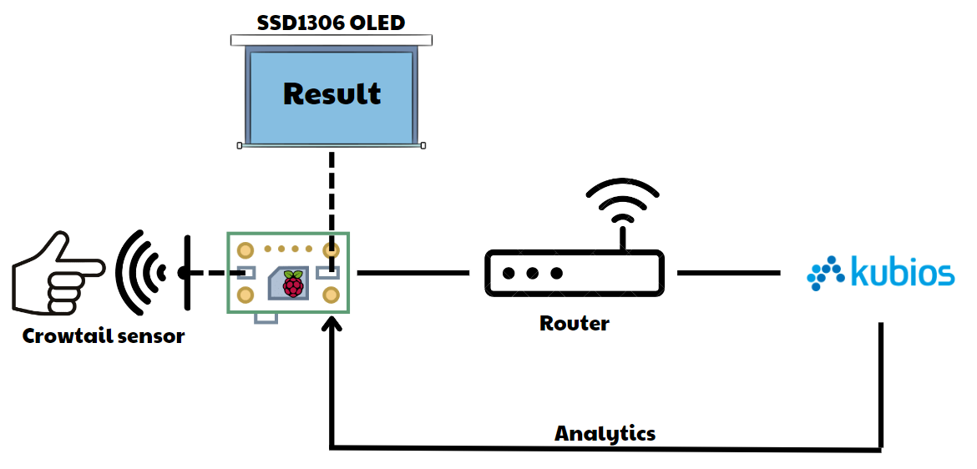


SYSTEM ARCHITECTURE

Slide 7
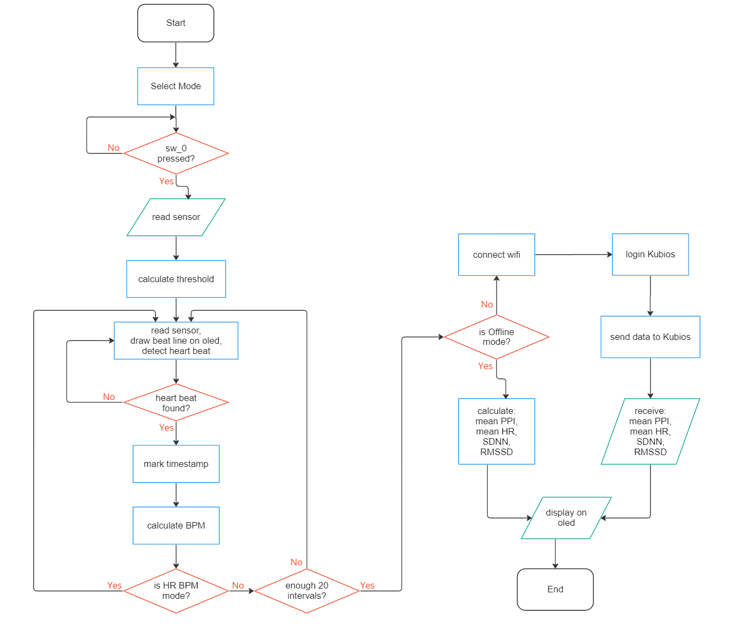
ALGORITHM

Slide 8
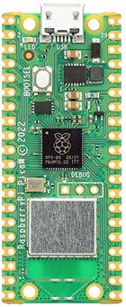
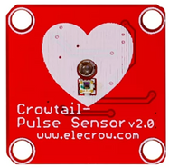


TECHNOLOGIES USED
Raspberry Pi Pico W
A low-cost, high-performance microcontroller designed for embedded applications comes with a fully certified module on board featuring 2.4GHz wireless LAN
Crowtail Pulse Sensor
A non-invasive sensor that measures heart rate and Heart Rate Variability (HRV) by detecting changes in blood volume in the fingertip.
Kubios cloud
A powerful API for analyzing heart rate variability data.
MicroPython Programming Language
A popular programming language for embedded system.

Slide 9




TESTING

Slide 10


FURTHER DEVELOPMENT IDEAS
Stress monitor
This project can be expanded to provide stress levels for users
Remote monitoring
The heart rate monitor could be expanded to allow for remote monitoring of patients, either in a hospital or home setting.
Wearable tech﻿nology
The Raspberry Pi heart rate monitor could be developed into a wearable device, such as a wristband or chest strap.
Smartphone Display
The collected heart rate data can also be displayed on smartphones

Slide 11

LESSONS LEARNED
Collaboration and teamwork
Problem-solving skills
Hardware interfacing
Debugging and troubleshooting
Real-world applications

Slide 12




CONTACT SUPPORT
+123-456-7890
https://www.metropolia.fi
KMD551, Karaportti 2
02610 Espoo , Finland

